Slide 1
CS6083 Database:
TWITTER_ADAPTOR
Team Member: Deep Patel, Hongye Gong, Yukun Liang
github link: https://github.com/hongyegong/CS6083

Slide 2
CONTENTS
INTRODUCTION
DATABASE DESIGNS
SAMPLE PRESENT
ACKNOWLEDGEMENT

Slide 3
1
Introduction

Slide 4
Introduction
The project definition is to work on Twitter API get tweets from the twitter server for the given keyword and store it to My-sql database on cloud.
The Scope of the project is to explore the APIs and find out a way to get GEO location (latitude, longitude) from the tweet and also do sentimental analysis on the tweet that is it negative, positive or neutral. Moreover ,User should be able to view, who tweeted and what was tweeted in temporal order.

Slide 5
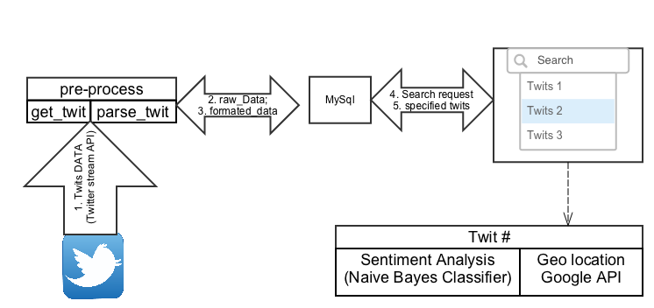
Work Flow

Slide 6
2
DATABASE DESIGN

Slide 7
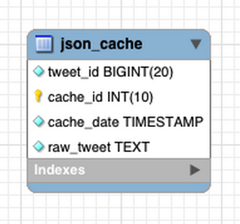
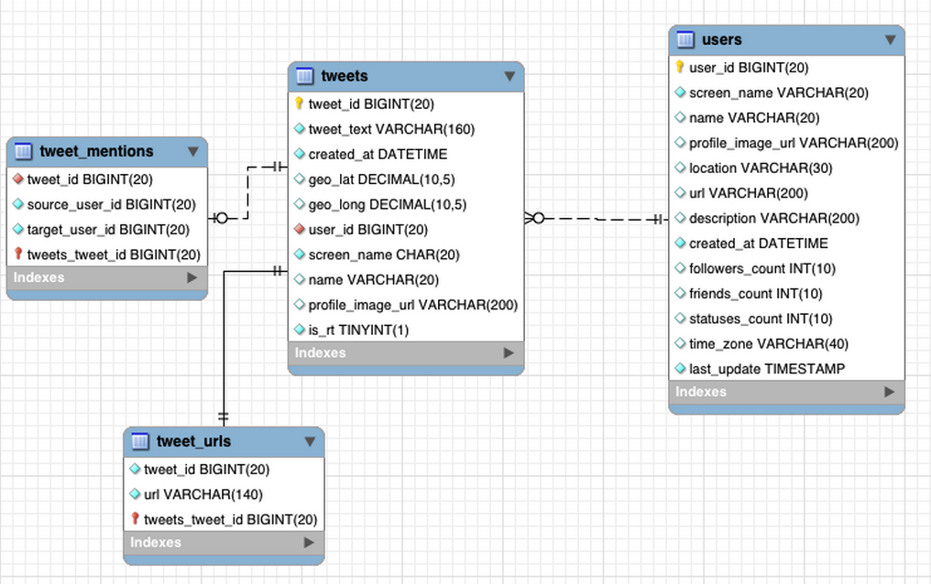
Database design
For Internal use to process retriving faster from twitter it is saved in following table in mysql. So this table is feed to parser to create actual normalized tables for our own system dataset.
Users : It contains user information and it is connected to tweet table with tweet_id.
Tweets : it contains inforamation related to tweets. which is connected to tweet_mentions and tweet_urls

Slide 8
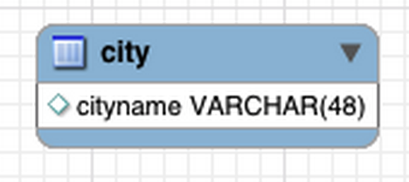
Database design
Moreover we have saperate table indexed which is used in our Geo coiding API preprocessing and make it faster.

Slide 9
3
SAMPLE SNAPSHOTS

Slide 10
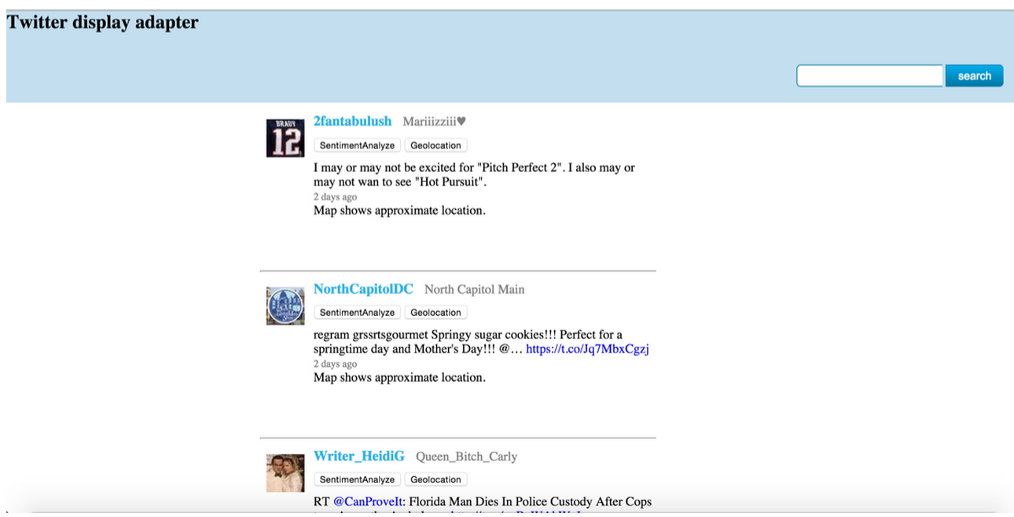
SAMPLE SNAPSHOTS

Slide 11
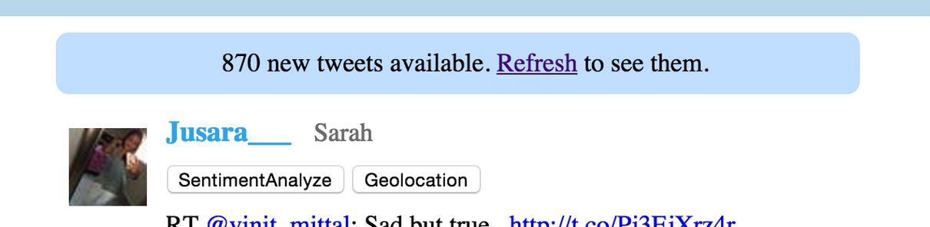
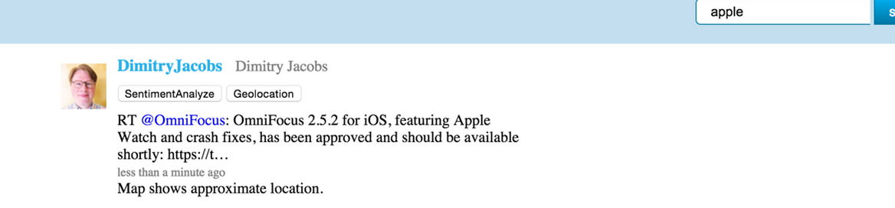
SAMPLE SNAPSHOTS
Get tweets of specific topics from tweet server in real-time:
Search whatever topics you want:

Slide 12
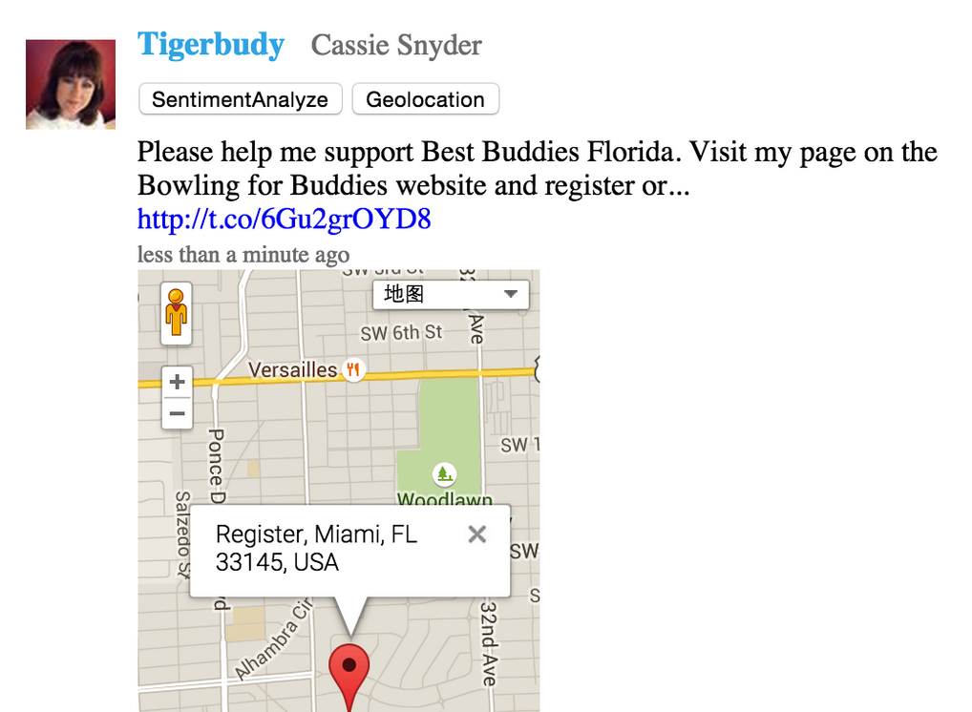
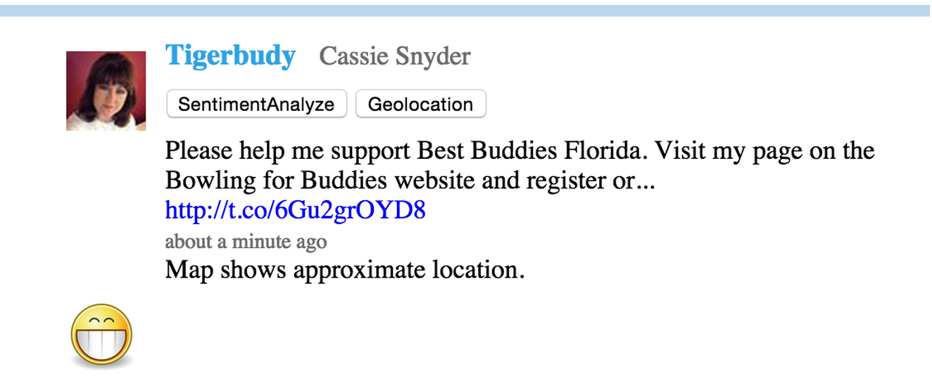
SAMPLE SNAPSHOTS
GEO location for each twitt
Sentiment analysis

Slide 13
4
ACKNOWLEDGEMENT

Slide 14
acknowledgement
Thanks for IBM for providing infrastructure and Prof. Raman Kannan for guiding.

